Slide 1

Prediction of Pedestrian Speed with Artificial Neural Networks
Kejia Gao (03779844)
Jingyi Zhang (03785924)
Maximilian Mayr (03738789)
Yizhi Liu (03779947)
Felipe Antonio Diaz Laverde (03766289)
08.07.2024

Slide 2
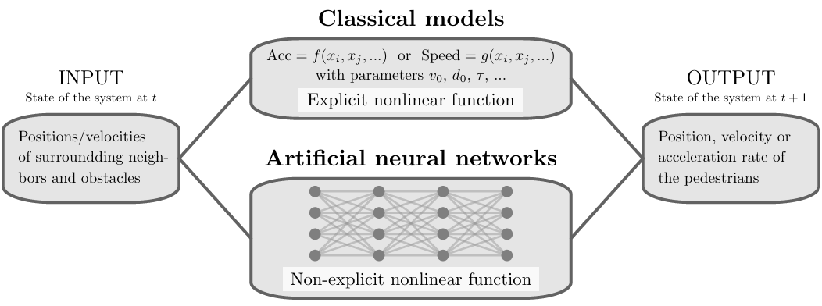
Background of the Research
"Prediction of Pedestrian Speed with Artificial Neural Networks"
by Antoine Tordeux, Mohcine Chraibi, Armin Seyfried, and Andreas Schadschneider

Slide 3
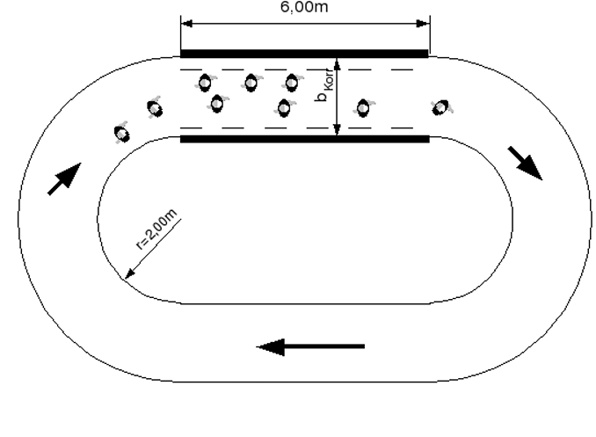
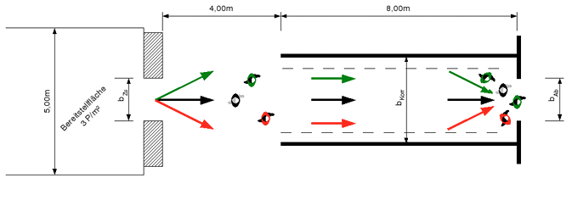
Background of the Research – Data
Project HERMES
Laboratory conditions
Unidirectional
Ring data
Bottleneck data
Sampling frequency 16Hz
50%/50% train-test-split

Slide 4
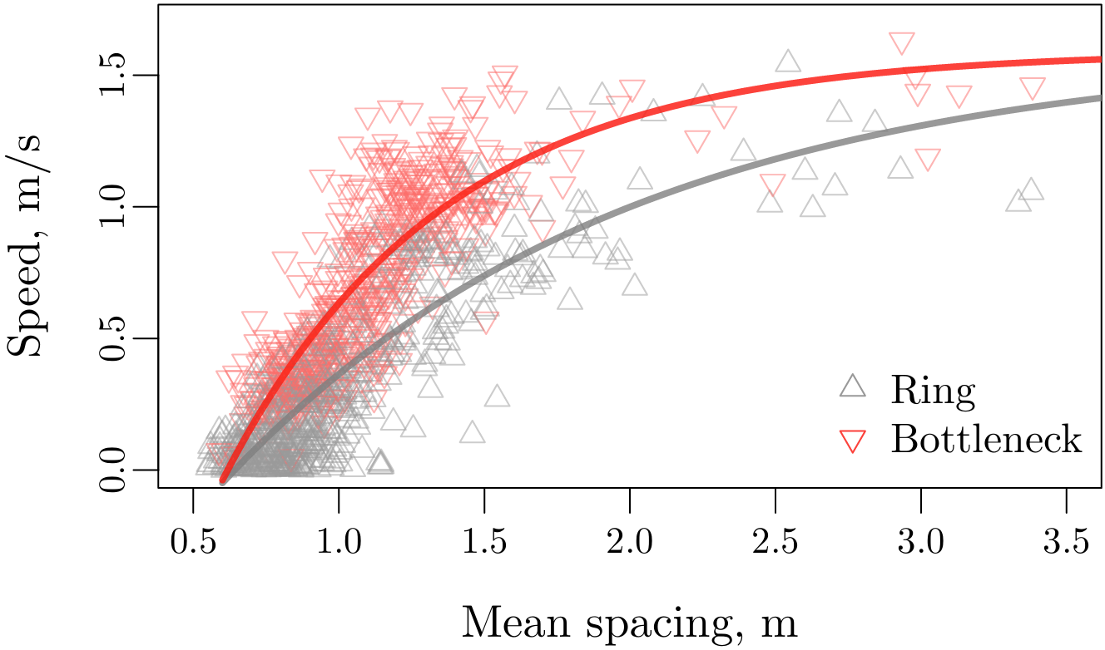
Background of the Research – Data

Slide 5

Background of the Research – Models
Weidmann model
$$v=v_{0}\left(1−\exp\left(\frac{l−{\overline{s}}_{K}}{v_{0}T}\right)\right)$$
Artificial neural network
$$v=NN\left(H, {\overline{s}}_{K},\left(x_{1}−x, y_{1}−y\right), …, \left(x_{K}−x, y_{K}−y\right)\right)$$

Slide 6
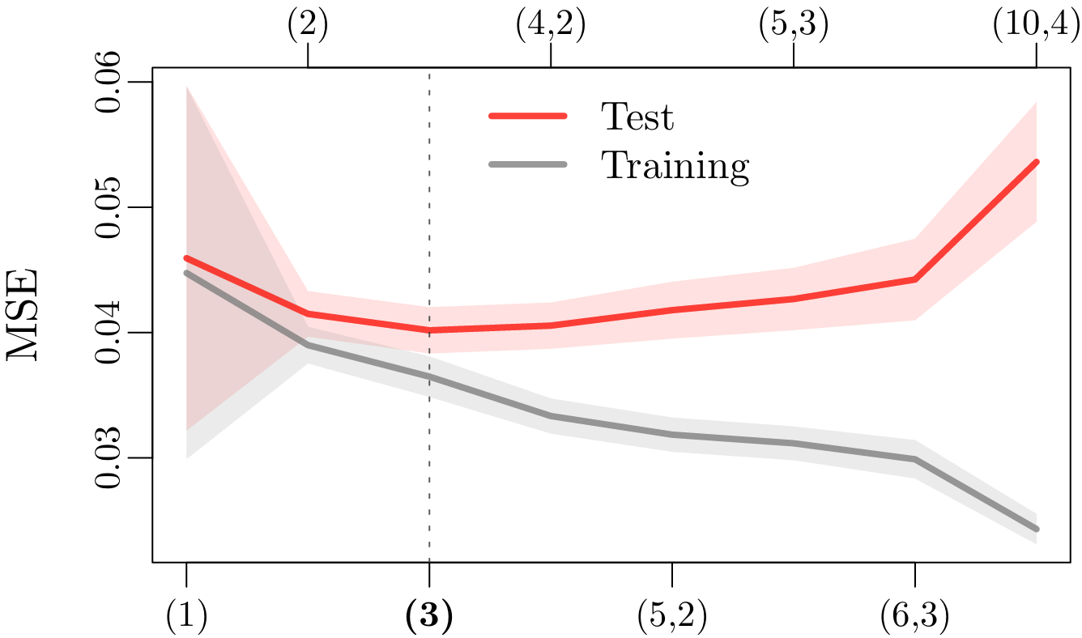
Background of the Research – Results

Slide 7
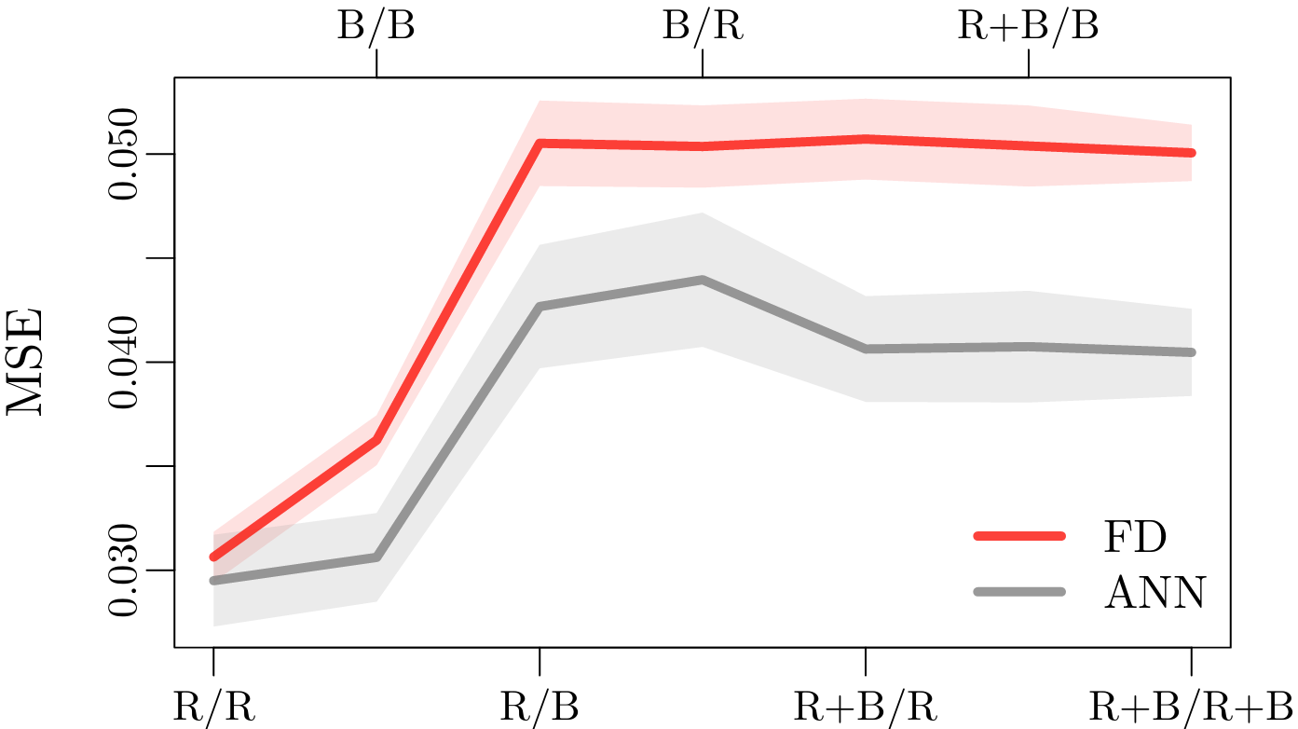
Background of the Research – Results

Slide 8
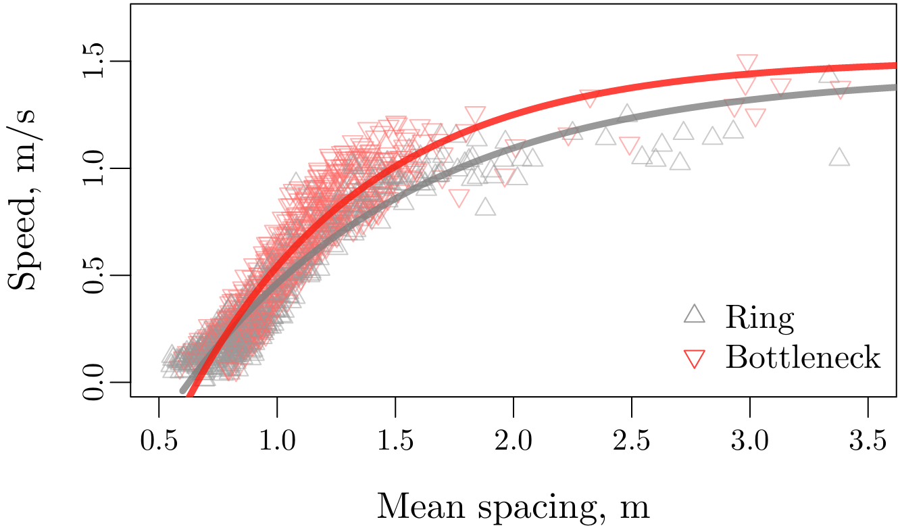
Background of the Research – Results

Slide 9
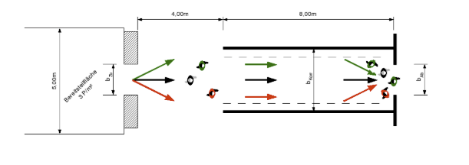
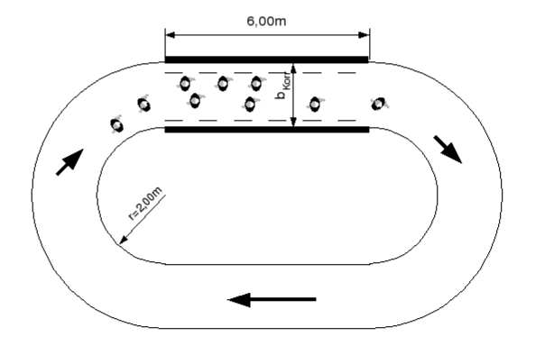
Data preprocessing
Dataset Overview: 2 scenarios
Bottleneck: The width of the system in front of the bottleneck is 1.8 m while the width of the bottleneck varies (from 0.70, 0.95, 1.20 to 1.80 m — 150 participants by experiment)
Corridor: Closed geometry of length 30 m and width 1.8 m for different density levels (the participant number ranges from 15 to 230)
Keip C, Ries K. Dokumentation von Versuchen zur Personenstromdynamik “[J]. Project Hermes, Bergische Universit ̈at Wuppertal, Tech. Rep, 2009.

Slide 10
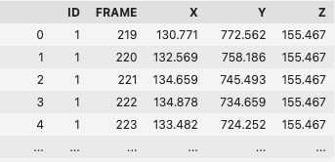
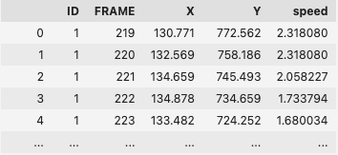
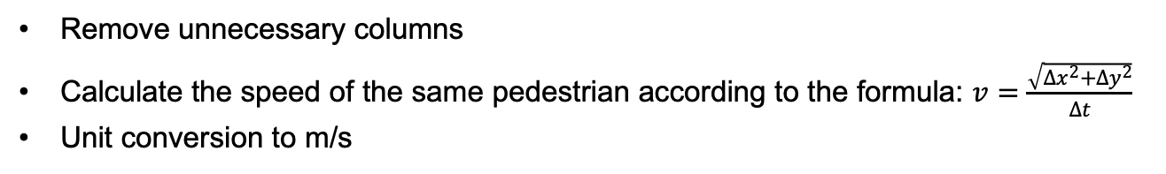
Data preprocessing
Adding speed:
Remove unnecessary columns
Calculate the speed of the same pedestrian according to the formula: $v=\frac{\sqrt{{∆x}^{2}+{∆y}^{2}}}{Δt}$
Unit conversion to m/s

Slide 11
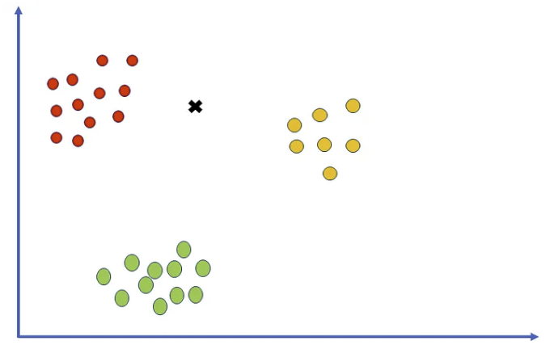

Data preprocessing
Finding nearest neighbors:
Grouping by Frame
Finds the 10 nearest neighbors for each point using Euclidean distance
calculates the mean spacing with the formula:
https://pub.towardsai.net/k-nearest-neighbors-knn-algorithm-tutorial-machine-learning-basics-ml-ec6756d3e0ac
Feature: Distance to neighbors, mean spacing
Target: Speed

